Slide 1

National Institute of Technology Sikkim
Development of Online Students’ Marksheet Generation and Distribution Management System
Prepared by:
Yash Gupta
Roll Number: B230038CS
Submitted to:
Dr. Sangram Ray
Assosiate Professor, NIT Sikkim

Slide 2
Table of Contents
Introduction
Problem Description
System Architecture
Entities and their Relations
E-R Diagram
SQL Queries
Relational Table
Snapshots of the Project
Conclusion

Slide 3
Introduction
What is the project about?
  The project is a secure, web-based system to automate the entire marksheet lifecycle.
Purporse:
- To replace inefficient, manual process with a modern, digital solution
- To provide a centralized platform for academic data management
Key Users:
- Administrators: For a system oversight and data management.
- Teachers: For efficient marks submission.
- Students: For secure, 24/7 access to their results
Core Benefits:
- Increases efficiency, ensures data accuraccy, and improves student satisfaction

Slide 4
Problem Description
Problems with existing manual systems:
Inefficiency and Delays:
Manual collection and calculation of marks is a slow and tedious process, costing both labour time and delays for overall operation.
High Risk of Human Error:
Human errors can creep up in marks and grade calculations if not done properly.
Lack of Centralization:
Data is scattered across physical files and spreadsheets, making it hard to manage and secure them.
Limited Student Access & Privacy Concerns:
- Students have to face time/location constraints to view results.
- Public noticeboards can compromise students’ privacy which can lead to unwanted comparisons and eventual demotivation in students.

Slide 5
System Architecture
Backend Framework: Django (Python)
Utilizes the Model-View-Template (MVT) architecture for a clean separation of concerns.
Database: MariaDB
A robust, open-source relational database for secure data storage.
Frontend: HTML, CSS, and JavaScript
Creates a responsive and user-friendly interface.
Key Libraries:
  Pandas: For processing spreadsheet uploads (.xlsx, .ods).
  ReportLab: For generating dynamic, secure PDF documents.
  qrcode: For creating data verification QR codes.

Slide 6
Entities and Relations
Problems with existing manual systems:
Core Entities:
Department
Course
Subject
Student
Teacher
Test
Result
Marksheet
Core Entities:
Department
Course
Subject
Student
Teacher
Test
Result
Marksheet
Key Relationships:
A Department offers multiple Courses.
A Course has many Subjects and enrolls many Students.
A Teacher is assigned to conduct a Test for a Subject.
A Student's performance in a Test is recorded as a Result.
The system generates a Marksheet for a Student each semester, but only after an Admin publishes it.

Slide 7
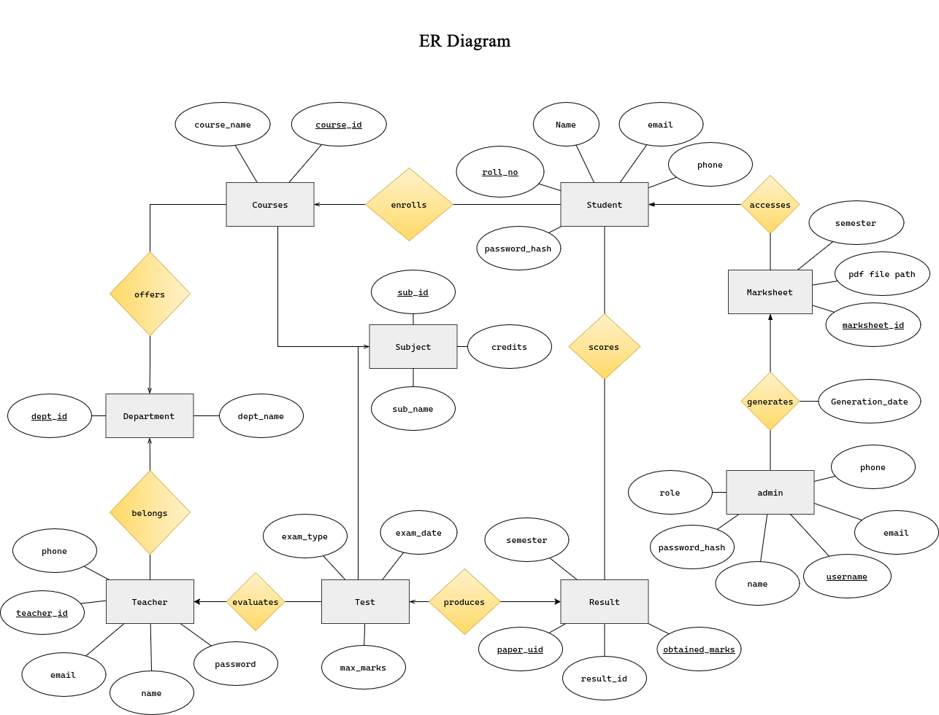
E-R Diagram

Slide 8
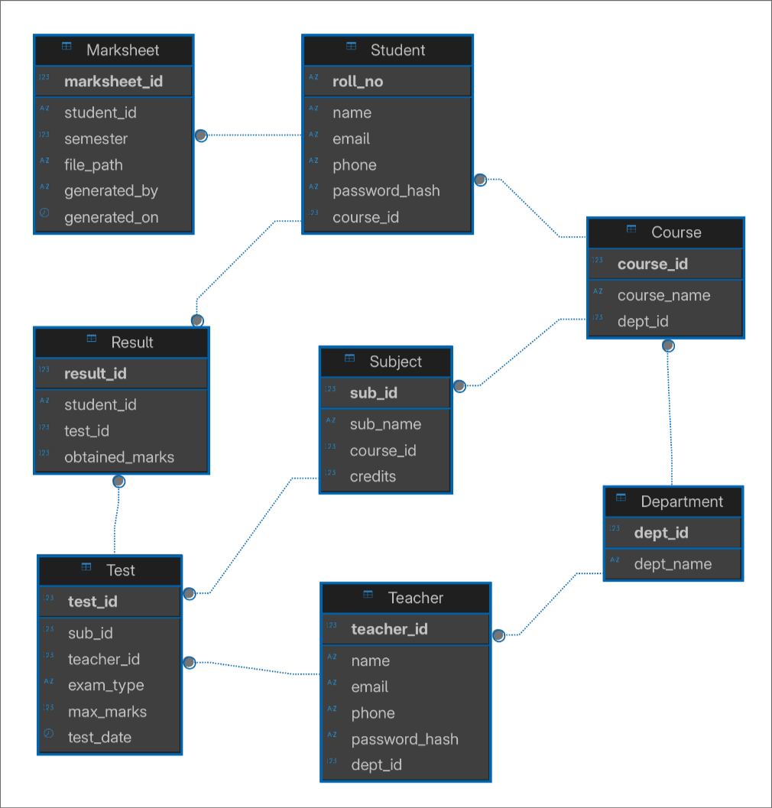
Relational Schema

Slide 9
SQL Queries (via Django ORM)
No Raw SQL: We use Django's Object-Relational Mapper (ORM) for database operations.
Benefits of ORM:
Productivity: Write database queries in Python, not SQL.
Security: Automatically protects against SQL injection attacks.
Portability: Easily switch databases (e.g., from MariaDB to PostgreSQL) with minimal code changes.

Slide 10
SQL Queries (via Django ORM)
Example: Fetching a student's results for a subject
Python (ORM) Code:
Example: Fetching a student's results for a subject
Python (ORM) Code:
Result.objects.filter(student__roll_no='B230038', test__subject__sub_code='CS15104')
Equivalent SQL Generated by Django:
SELECT * FROM academics_result
INNER JOIN academics_test ON academics_result.test_id = academics_test.id
WHERE academics_result.student_id = 'B230038'
AND academics_test.subject_id = (SELECT id FROM academics_subject WHERE sub_code = 'CS15104');

Slide 11
Relational Table
Student Table:
roll_no (Primary Key)
name, email, father_name, mother_name, reg_no
course_id (Foreign Key to Course)
user_id (Foreign Key to Django's User table)
Subject Table:
id (Primary Key)
sub_code (e.g., CS15104)
sub_name, credits
course_id (Foreign Key to Course)
Result Table:
id (Primary Key)
obtained_marks
student_id (Foreign Key to Student)
test_id (Foreign Key to Test)
Marksheet Table:
id (Primary Key)
is_published (Boolean)
student_id (Foreign Key to Student)
semester

Slide 12
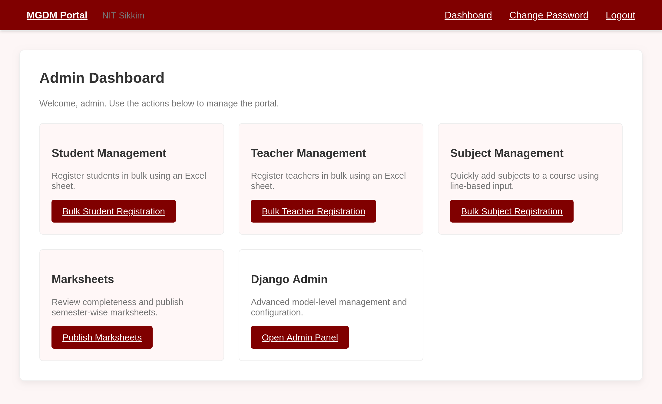
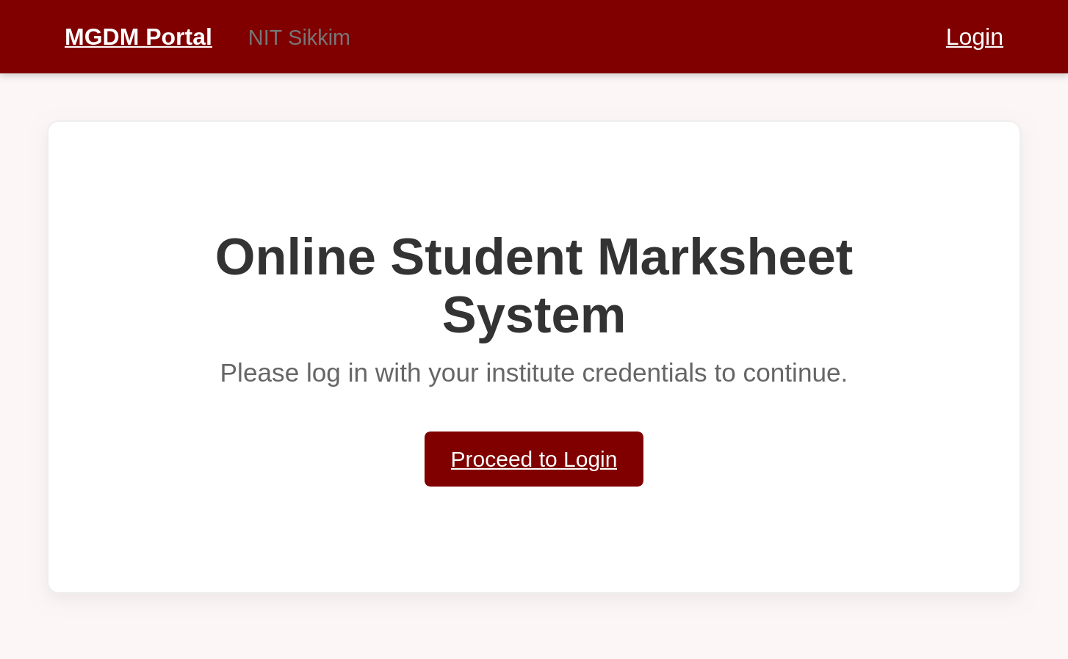
Snapshots of the Project
Home Page
Admin Dashboard

Slide 13
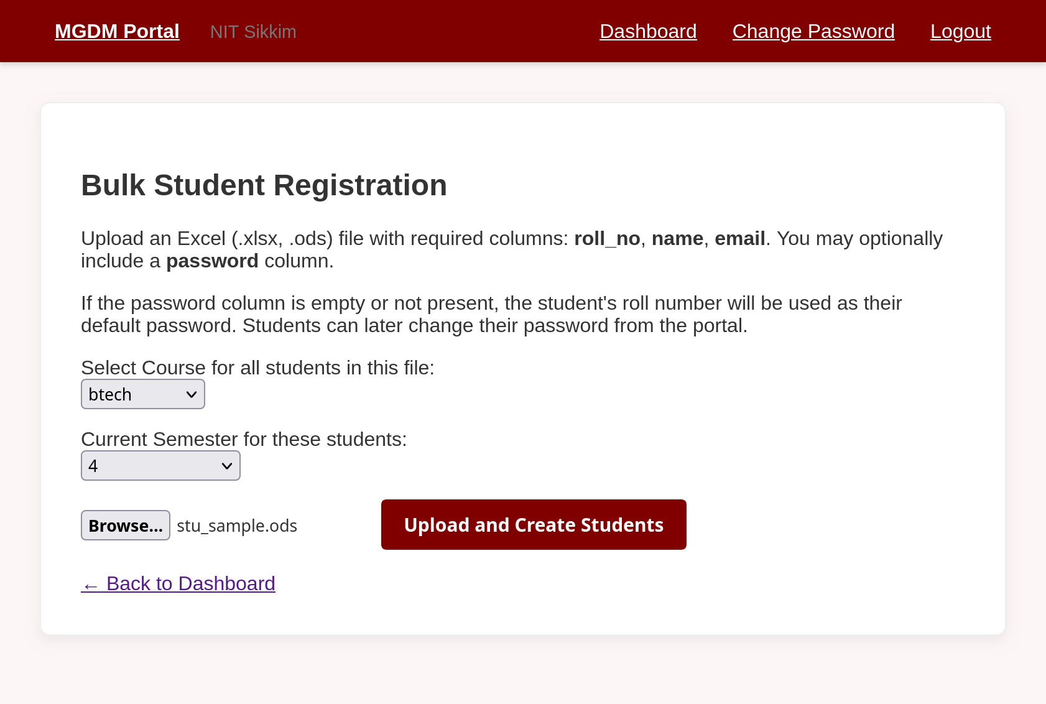
Snapshots of the Project
Bulk Student Registration Page

Slide 14
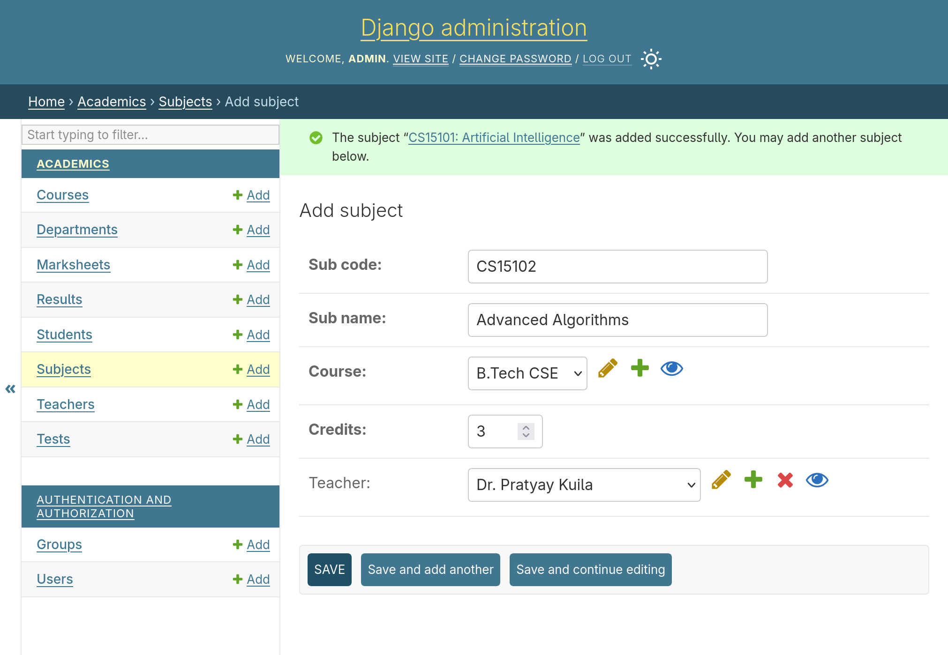
Snapshots of the Project

Slide 15
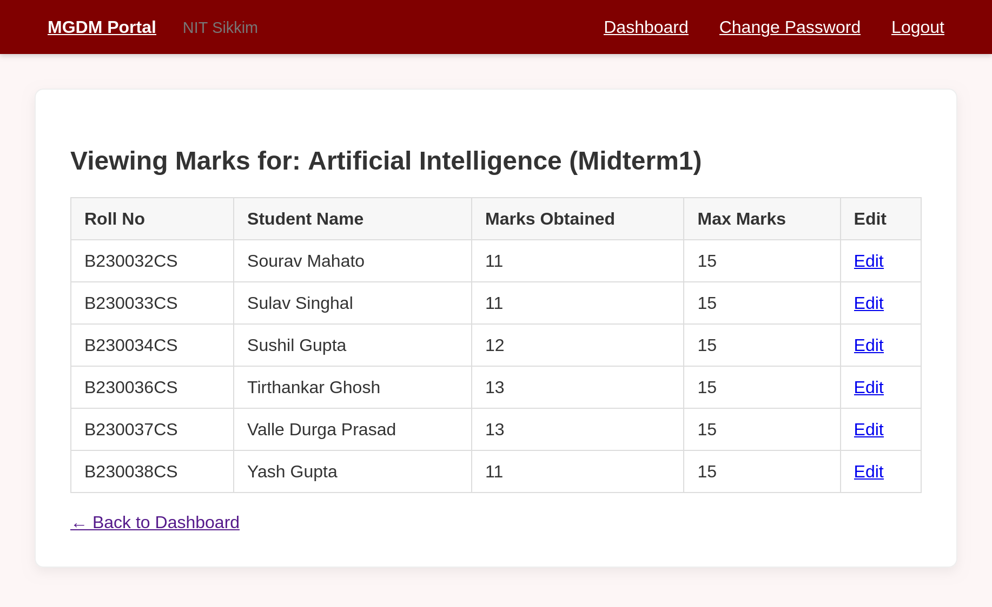
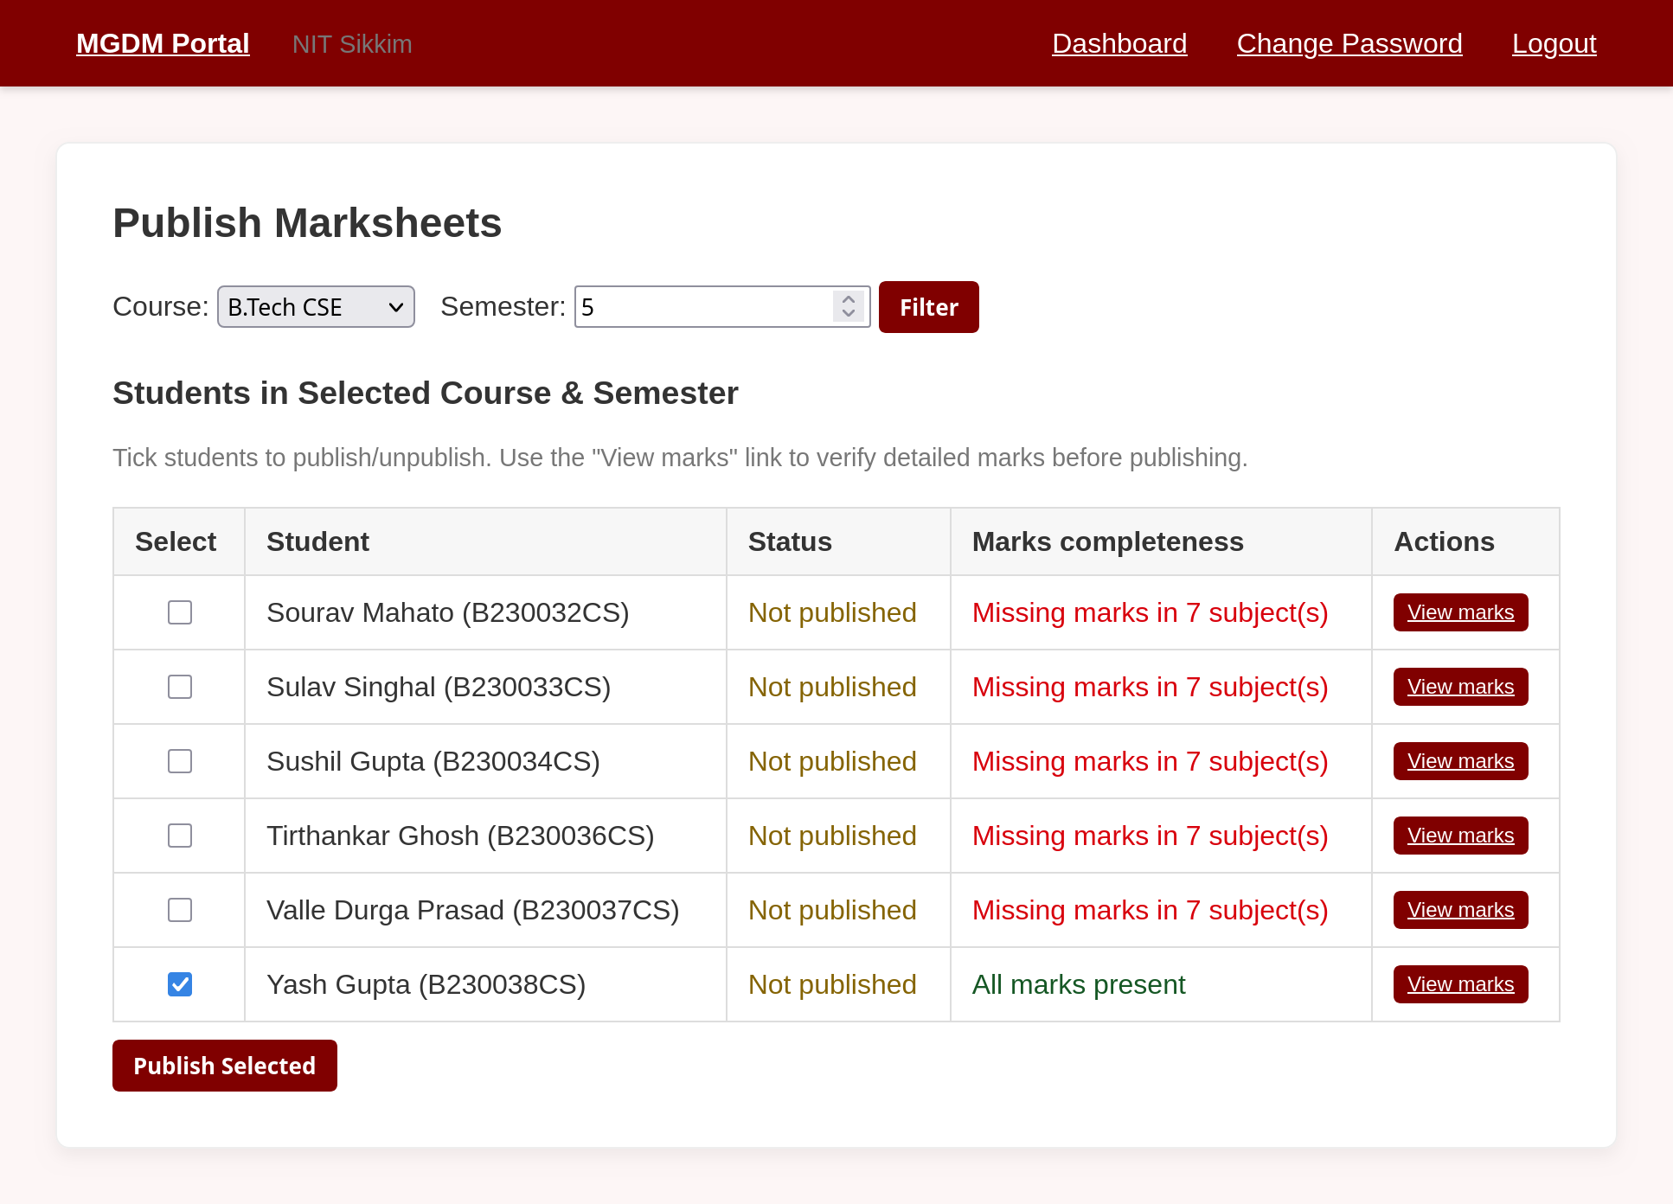
Snapshots of the Project
Teacher’s View

Slide 16
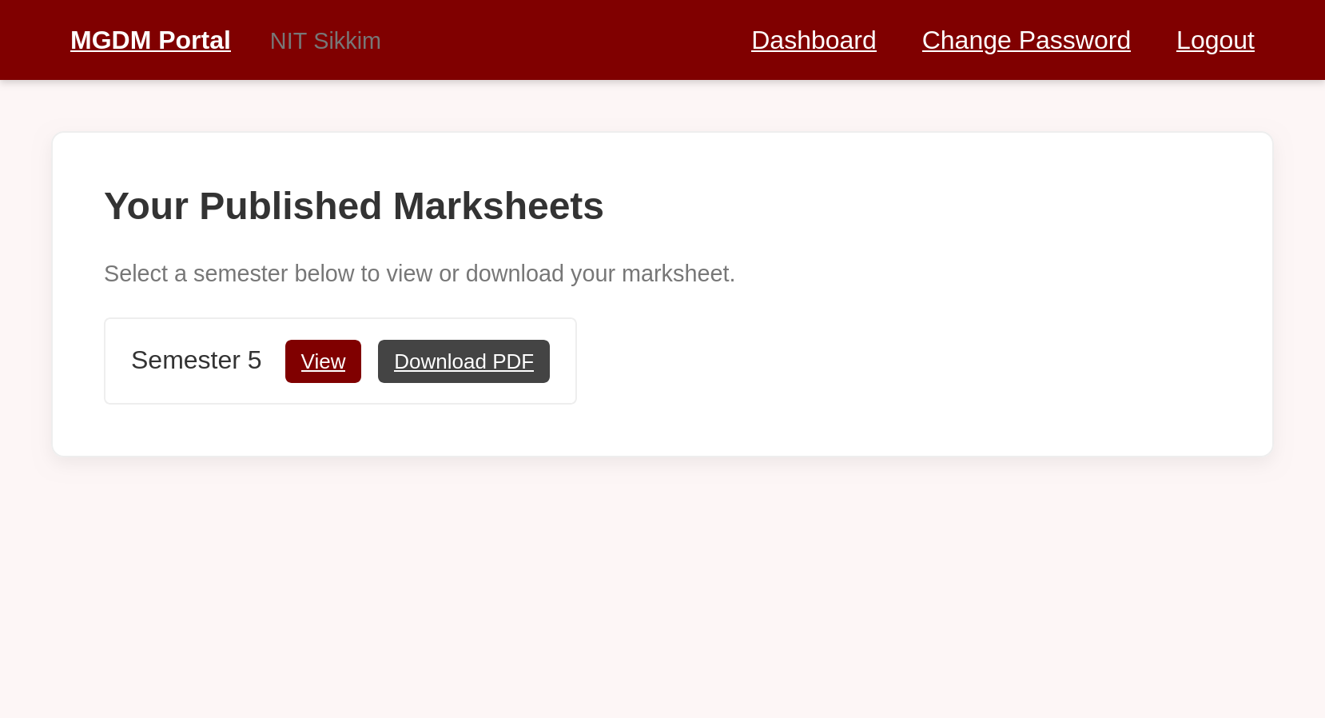
Snapshots of the Project
Student’s View

Slide 17
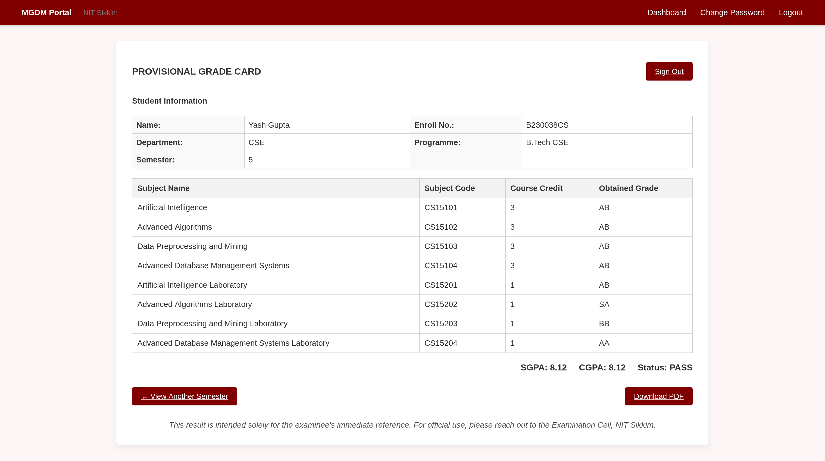
Snapshots of the Project

Slide 18
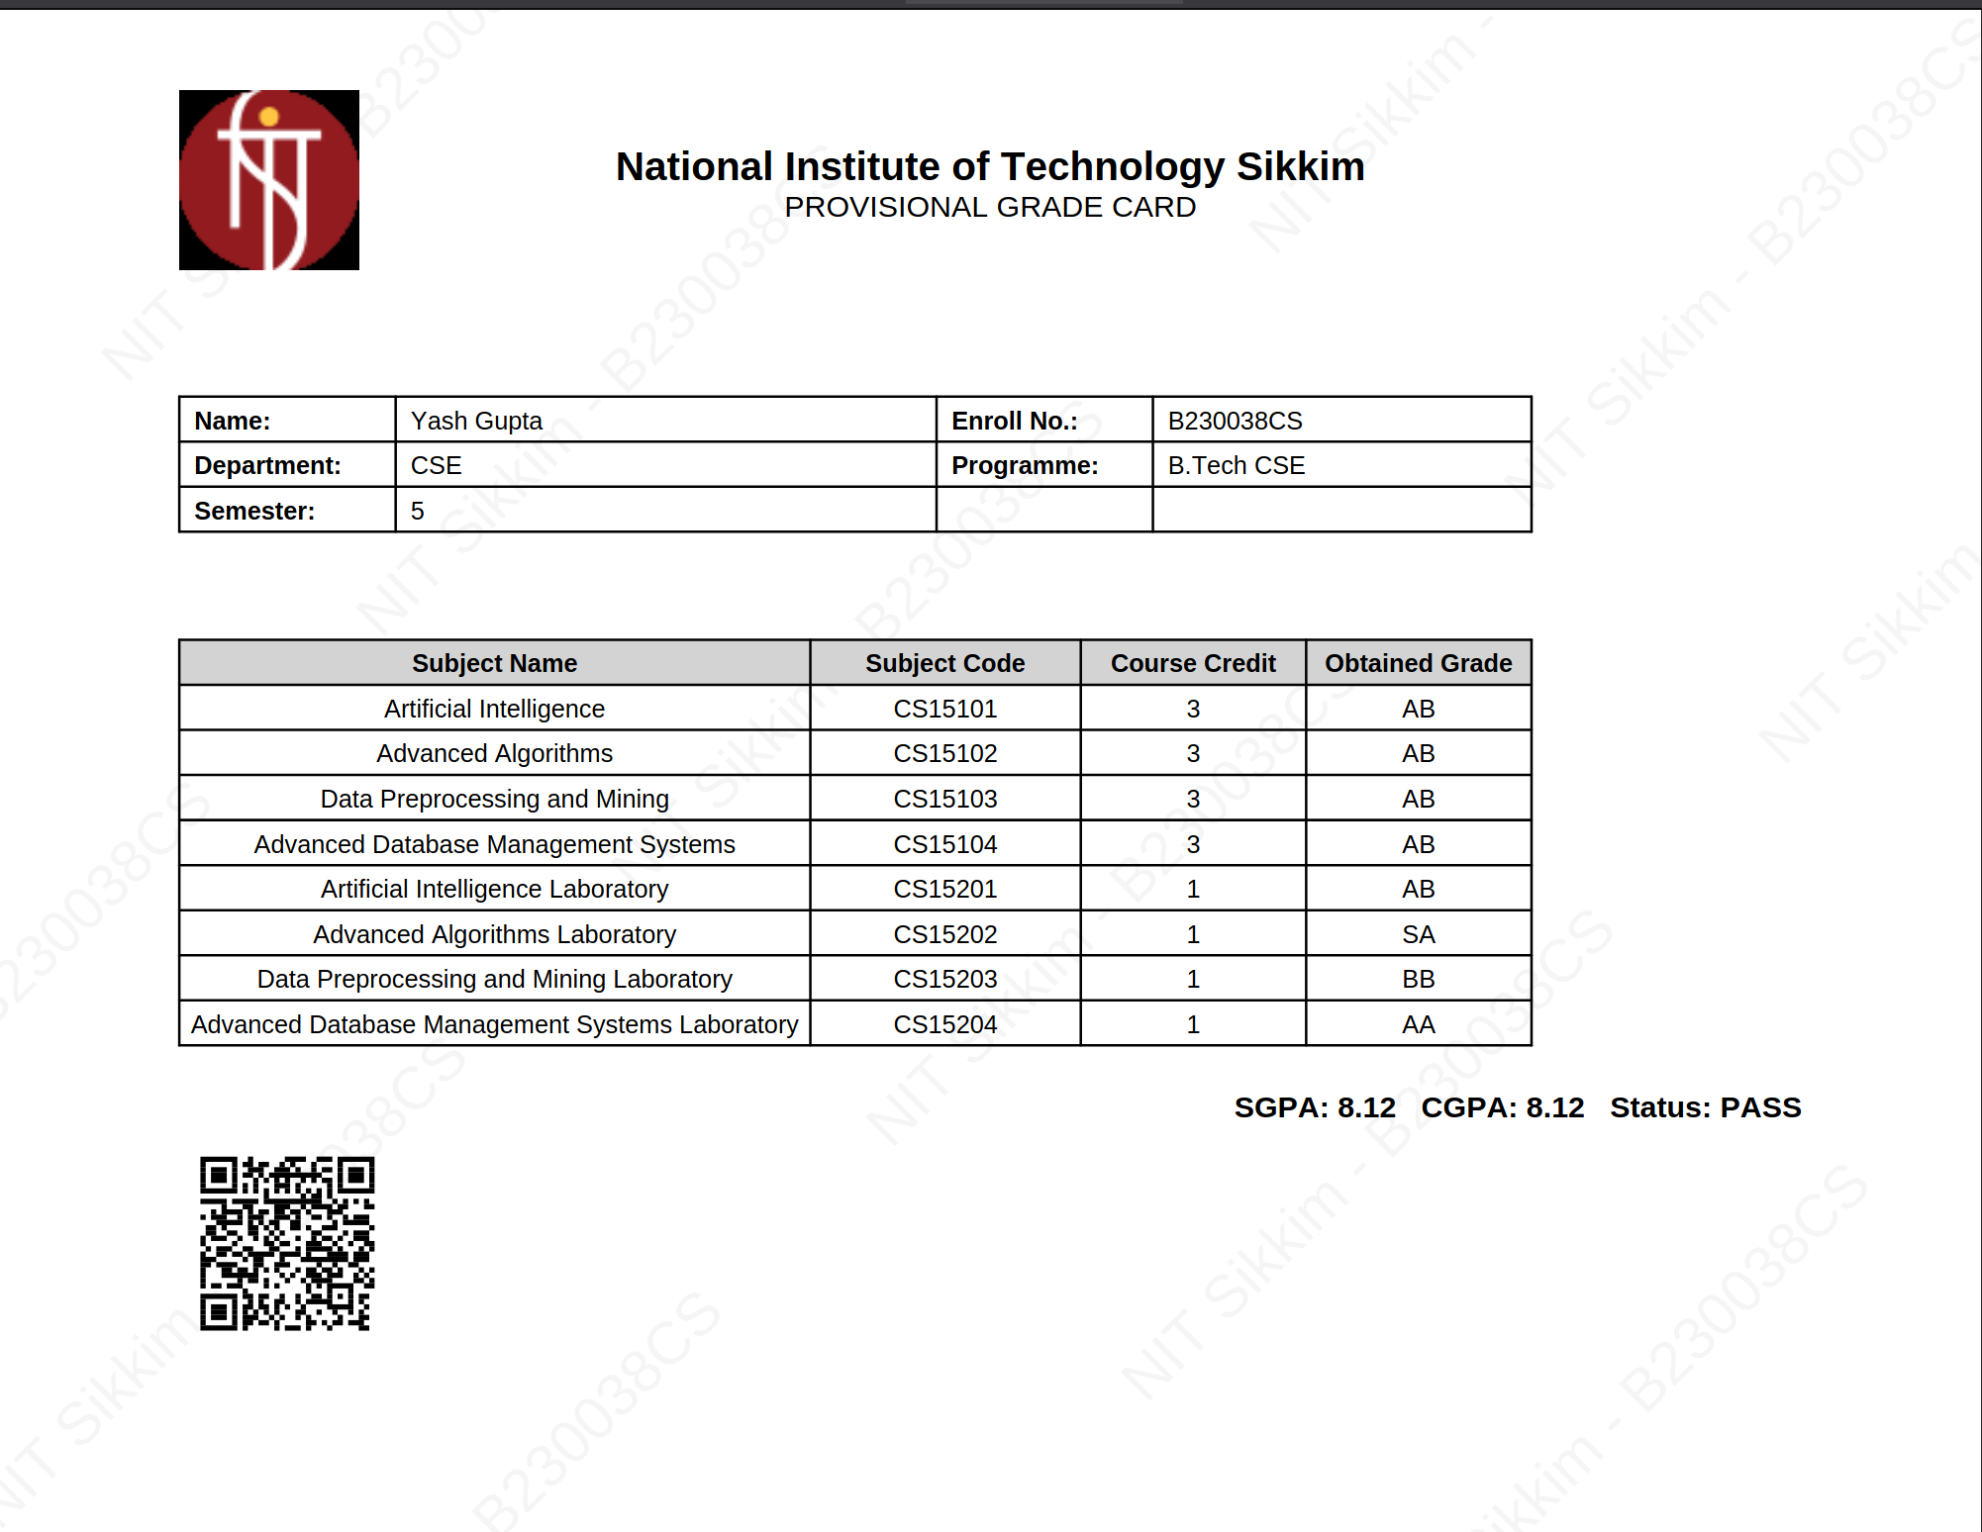
Snapshots of the Project
Generated PDF Marksheet

Slide 19
Conclusion
Completion of Project:
Successfully developed a fully functional, multi-user system for marksheet management.
Automated key process of marksheet generation and distribution, reducing manual effort and eliminating calculation errors.
Delivered a secure, efficient, and user-friendly platform for all stakeholders.

Slide 20
Conclusion
Future Scope:
Transcript Generation: Add a feature to generate a consolidated transcript for all semesters.
Password Recovery: Implement a secure "Forgot Password" feature via email.
Analytics Dashboard: Provide administrators with visual analytics on student performance.

Slide 21
Thankyou!!!

